Slide 1
ODOT Image Recognition PoC By Dakota Rennels, DS OMES Data Science Team

Slide 2





Outline
Executive Summary
PoC Disclaimers
Data Overview
Process Methodology & Model Results
Next Steps

Slide 3
Executive Summary

Slide 4
Executive Summary
Business Goals:
Build image recognition model to identify 5 objects:
Pavement Markings, Signs, Guardrails, Light Poles, & Rumble Strips
Compare changes in images year-over-year (YoY)
Log Latitude (Lat) and Longitude (Lon) of each image
Data Outcomes:
Preform OCR to pull exact Lat/Lon from each image
Developed process for mapping relative Lat/Lon to showcase YoY change
Developed process for assessing delta “error” of relative location YoY
Images were taken from moving vehicle

Slide 5
Proof of Concept Disclaimers

Slide 6
Proof of Concept (PoC) Disclaimers
Disclaimer of work:
The work done in this PoC was done to showcase 2 different outcomes:
That object detection could be handled internally by the Data Science (DS) team.
That our team is capable of configuring this object detection tooling to the needs of ODOT.
Disclaimer of PoC usage:
The work in this PoC was done to fulfill a specific business outcome for ODOT.
The model structure and processes used in the PoC will be assessed by the internal DS team to improve future methodologies and image recognition offering.
A high-level overview of this PoC will be used to showcase the DS team’s ability to perform this technical work.

Slide 7
Data Overview

Slide 8
Data Overview
Images from FY2020-2022 provided
Three folders of images based on view
Panoramic, DriverRear, PassengerRear
Focused on Panoramic view for PoC
This folder has ~2,400 images per year

Slide 9
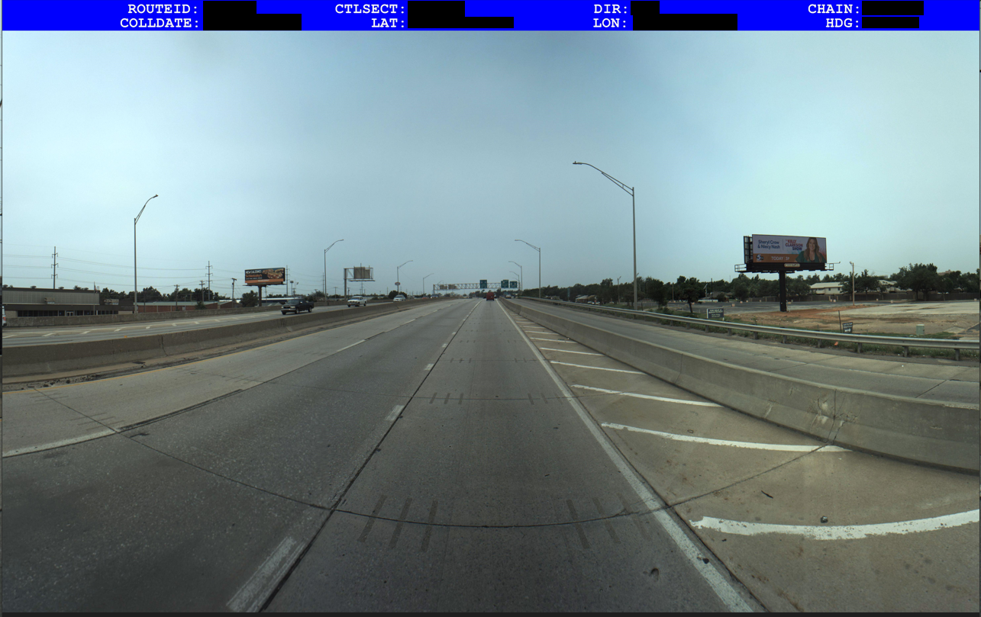
Data Overview
Image data contained:
Image of road in either front, rear, or panoramic view
Metadata with several categories:
ROUTEID
CTLSECT
DIR
CHAIN
COLLDATE
LAT
LONG
HDG

Slide 10
Object Detection Process Methodology and Model Results

Slide 11
Methodology Overview
Mapping Images
Image Annotation
Training the Model
Assessing Model Results
How to Use Model Results

Slide 12
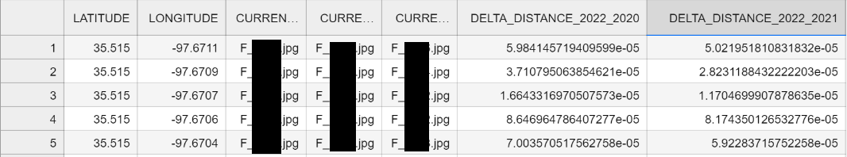
Mapping Images Step
Each image went through an OCR step to extract Latitude/Longitude integers. (CTLSECT, CHAIN labels also extracted for final analysis)
The latitude and longitude values were stored in dataframes separated by year
The values were then calculated using the “cdist” function to calculate distance minimum distance for pairing images.
Using 2022 as the benchmark, the delta distance from the closest match per year to the 2022 image was captured.
The “e-05” in delta distance is translated to matching within 1 meter distance

Slide 13
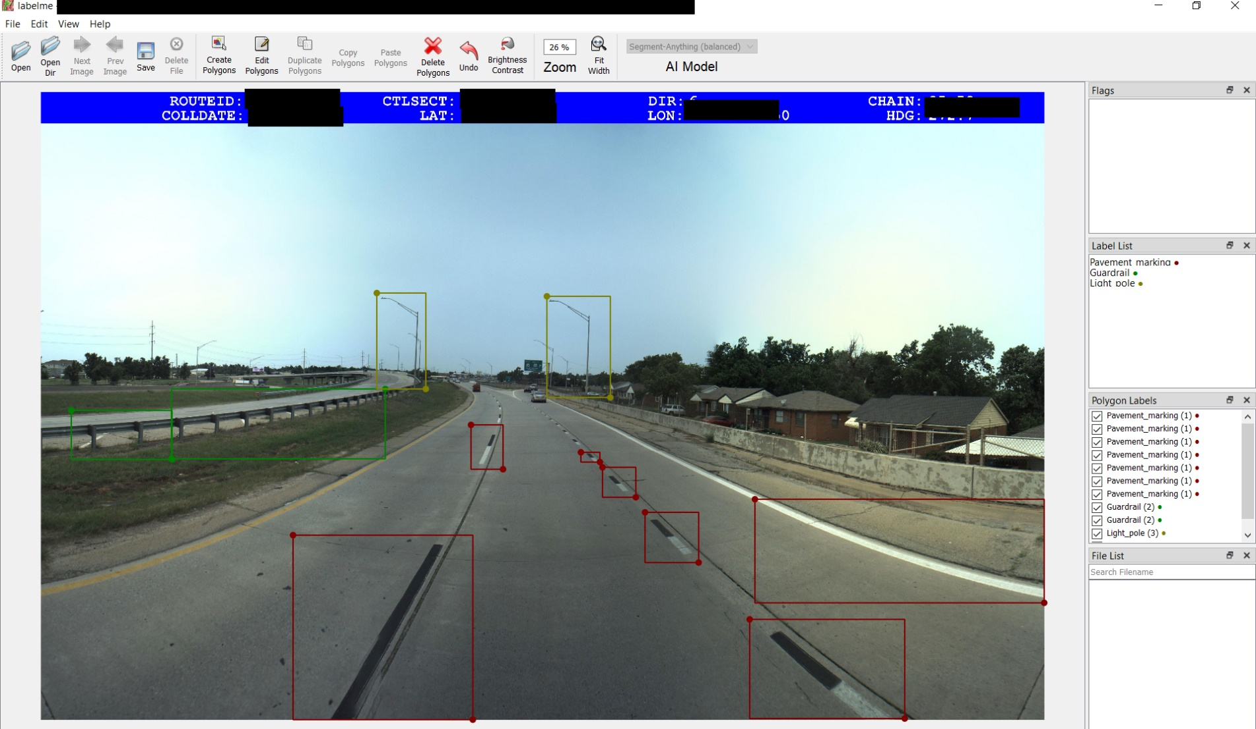
Image Annotation Step
~50 Training Images
By far, the most difficult piece of the PoC.
Each training image was hand annotated using an annotation tool.
The image on the right was done using labelme. We also used labelimg, almost identical tools.
As models are trained, the need to hand annotate becomes less.

Slide 14
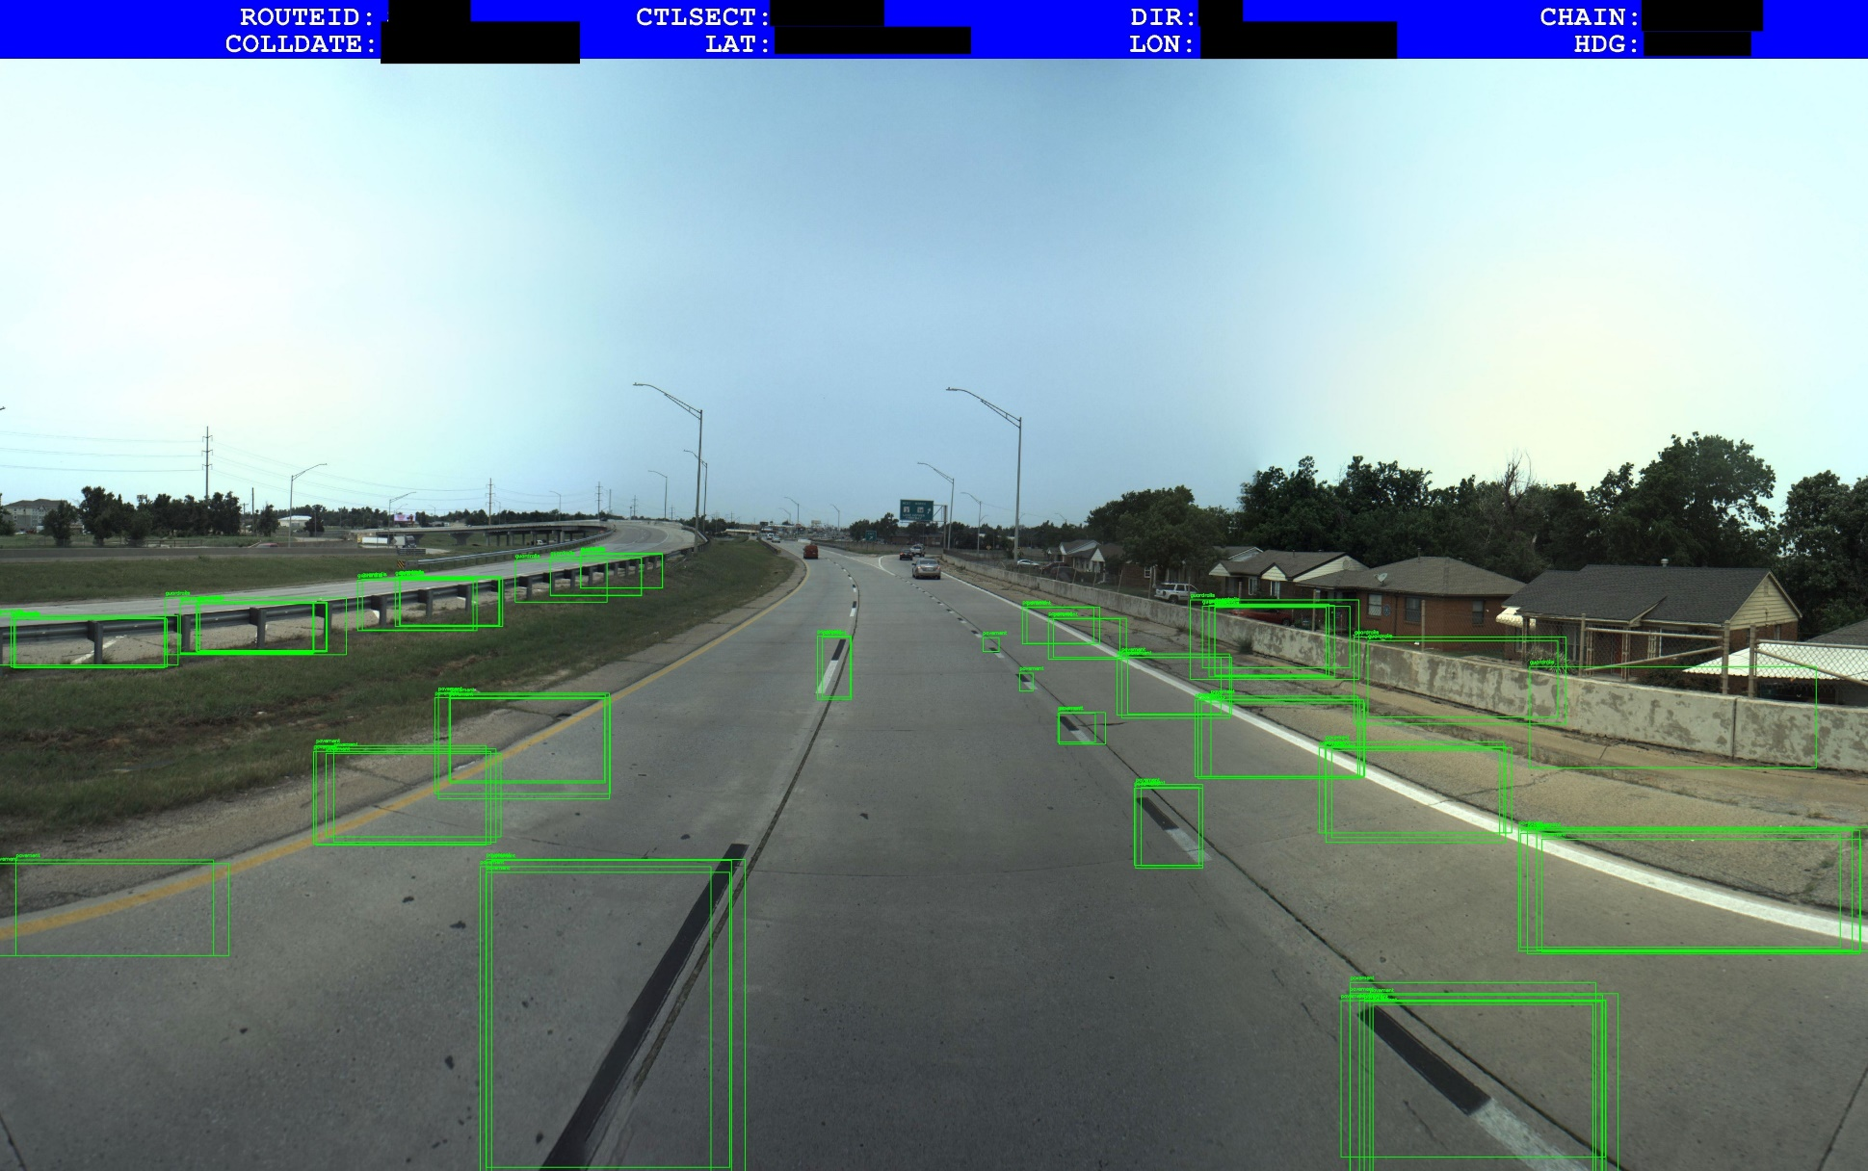
Assessing Initial Model Results Step
Initial model was detecting objects at very high accuracy.
Image on the right showcases model detecting various examples of categories.
Model will need to be fine-tuned to remove multiple bounding boxes from localized area of image. Aka, one bounding box for one object.

Slide 15
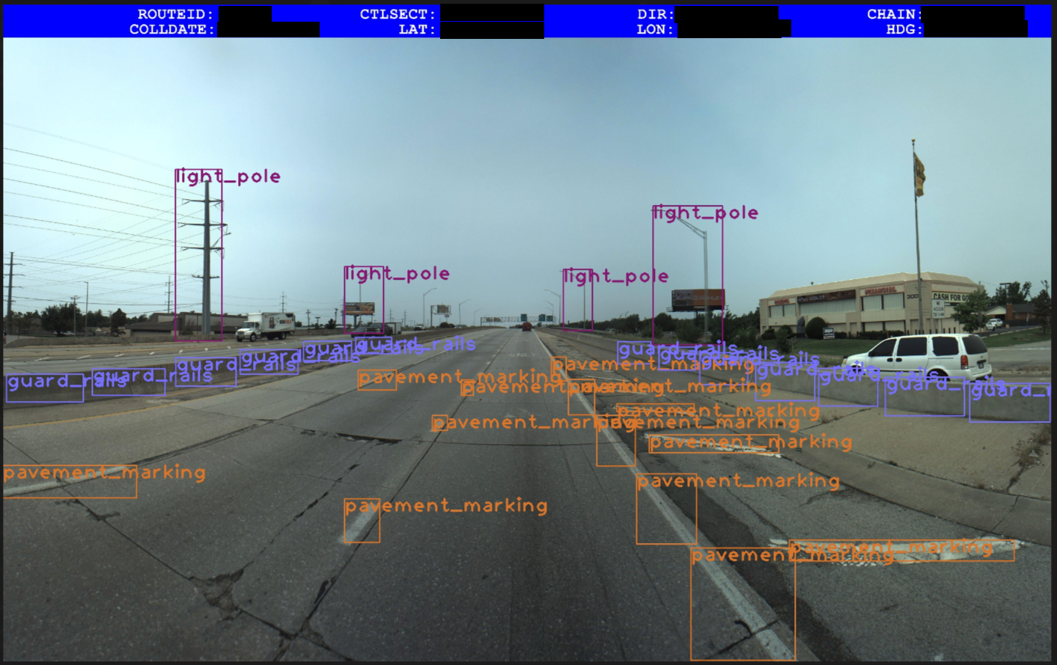
Assessing Model Results Step
The refined model now has a more robust categorization process.
Image on the right showcases model with more refined categories.
As seen, the model categorized a utility pole as a light pole. This can be refined in further training iterations.

Slide 16
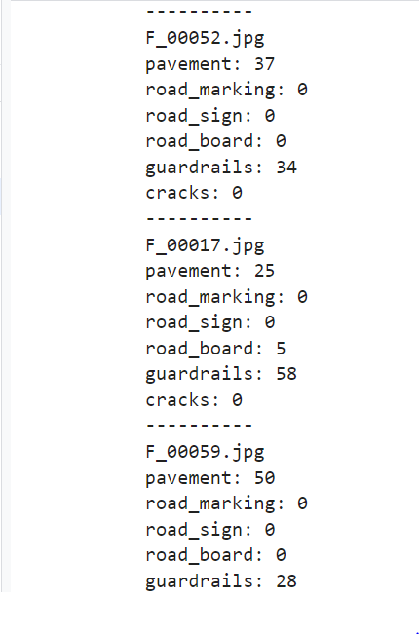
How to Use Model Results
Once the bounding boxes have been cleaned to single out objects, we are now totaling the boxes in tabular format.
From these boxes, we will provide totals based on categories and generate a total sum.
These totals will then be used to calculate a delta change year over year from previous images.
The output will be ingested into a Power BI dashboard to allow drill down and top-level analytics for the business.

Slide 17
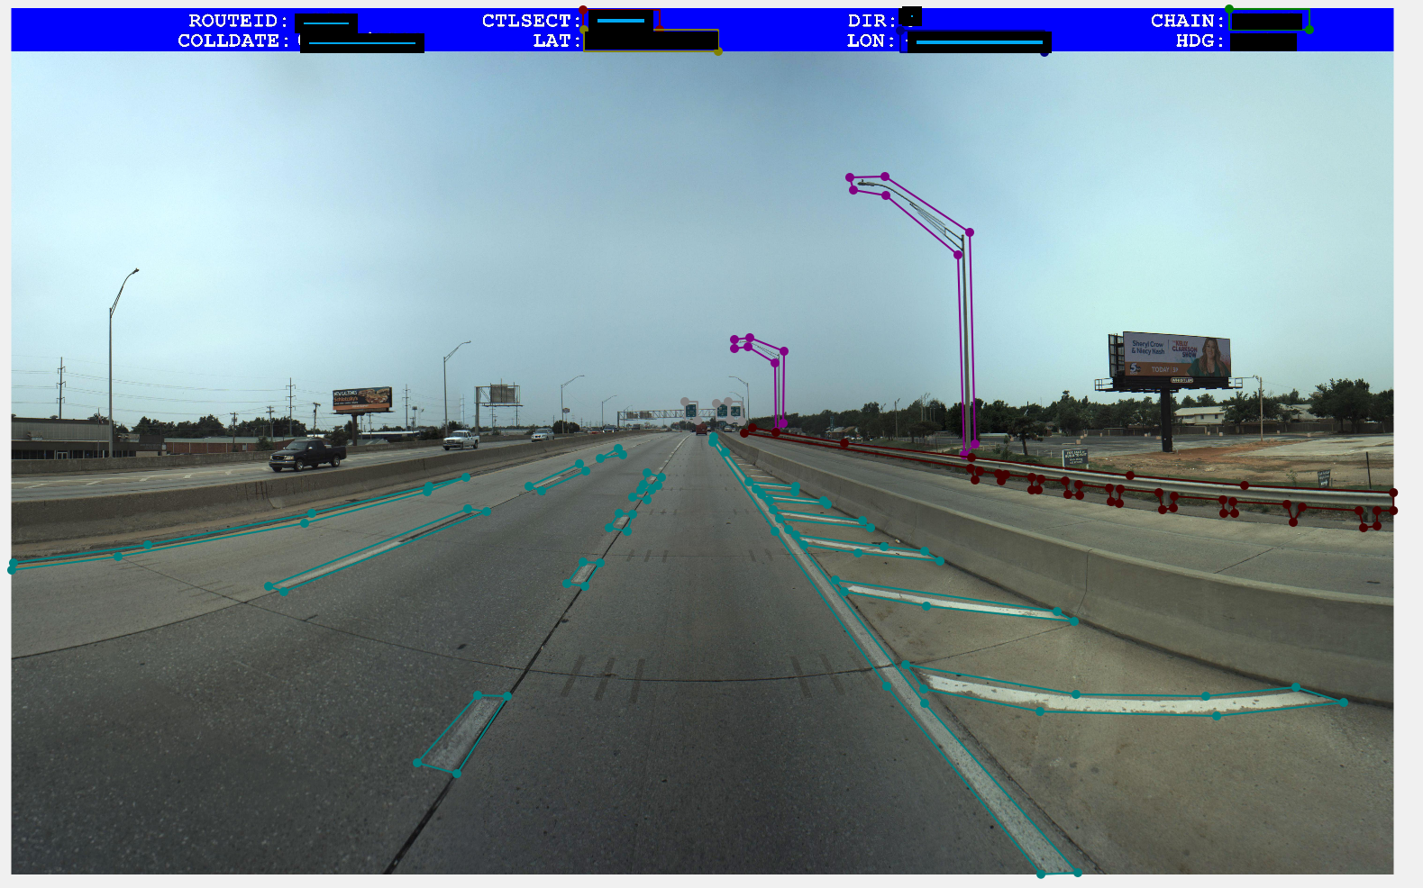
Future Improvements
One improvement would be moving away from bounding boxes and moving to polygon bounding.
This will improve:
Detection localization
Reduce overlapping
Higher Intersection of Union (IoU) values
Improve Staking Unit methods
Detailed sub-category recognition
This will cause:
Time-Consuming annotations
Increase model computation demands
Increase model complexity

Slide 18
PoC Image Rec Next Steps

Slide 19
Next Steps
Customer acceptance of process and output.
Verify key variables and measures are delivered:
CTLSECT
CHAIN
LAT
LON
Count of each bounding box per image
Bounding box count for each category in the image
Delta YoY for total bounding boxes
Delta YOY for each category
Create a Dashboard/Application for business use.
Finalize this deck for hand-off.
Technical documentation for our process to handle object detection.
Discuss future engagement with improvements/scalability.

Slide 20



Thank You

